Slide 1

Information Systems Lecture Presentation - “Maps with Python Folium”
Patrick J. Slattery for Job ID: 23771, 20-Apr-2023
Colab Notebook: https://bit.ly/is_lecture_presentation
Class Slides:
https://bit.ly/is_lecture_slides

Slide 2

“I'd go to the farmers' market in Santa Barbara, and I'd put out my guitar case, and I'd test out these little ditty songs that I would write, and I would get a couple of avocados, a bag of pistachios, and, like, fifteen bucks. That was a lot of money for me.”
― Katy Perry
4/19/2023
© 2018 – 2023, Professor Patrick Slattery
2
IS Lecture Presentation for Job ID 23771

Slide 3
Online Class Notice
Class sessions and office hours are held online using Zoom, Blackboard Collaborate Ultra and other similar platforms. A network connection, display device and speakers are required to participate. A microphone and webcam are also recommended. Class recordings are available in Blackboard Collaborate Ultra.
Students who participate in this class with their camera on or use a profile image are agreeing to have their video or image recorded solely for the purpose of creating a record for students enrolled in the class to refer to, including those enrolled students who are unable to attend live. If you are unwilling to consent to have your profile or video image recorded, be sure to keep your camera off and do not use a profile image. Likewise, students who un-mute during class and participate orally are agreeing to have their voices recorded. If you are not willing to consent to have your voice recorded during class, you will need to keep your mute button activated and communicate exclusively using the "chat" feature, which allows students to type questions and comments live.

Slide 4
Agenda
Zoom Notice, Introduction, and Configuration | 12:35 – 12:50
Create a Basic Map in Folium: San José feria | 12:50 – 01:00
Markers in Folium: San José feria | 01:00 – 01:15
Some Fun with IFrame Markers: San José feria | (optional)
Exercise: Dublin Bikes | (homework)
Q&A and Housekeeping | 01:15 – 01:30
This lesson works with an accompanying Jupyter notebook on Google Colab at https://bit.ly/is_lecture_presentation

Slide 5
Introduction (IS Lecture Presentation)
Patrick J. Slattery for Job ID 23771, 20-Apr-2023

Slide 6

Our work today will take us traveling to San José, Costa Rica in Central America and across the Atlantic to Dublin, Ireland
4/19/2023
© 2018 – 2023, Professor Patrick Slattery
6
IS Lecture Presentation for Job ID 23771
image courtesy of Microsoft PowerPoint

Slide 7
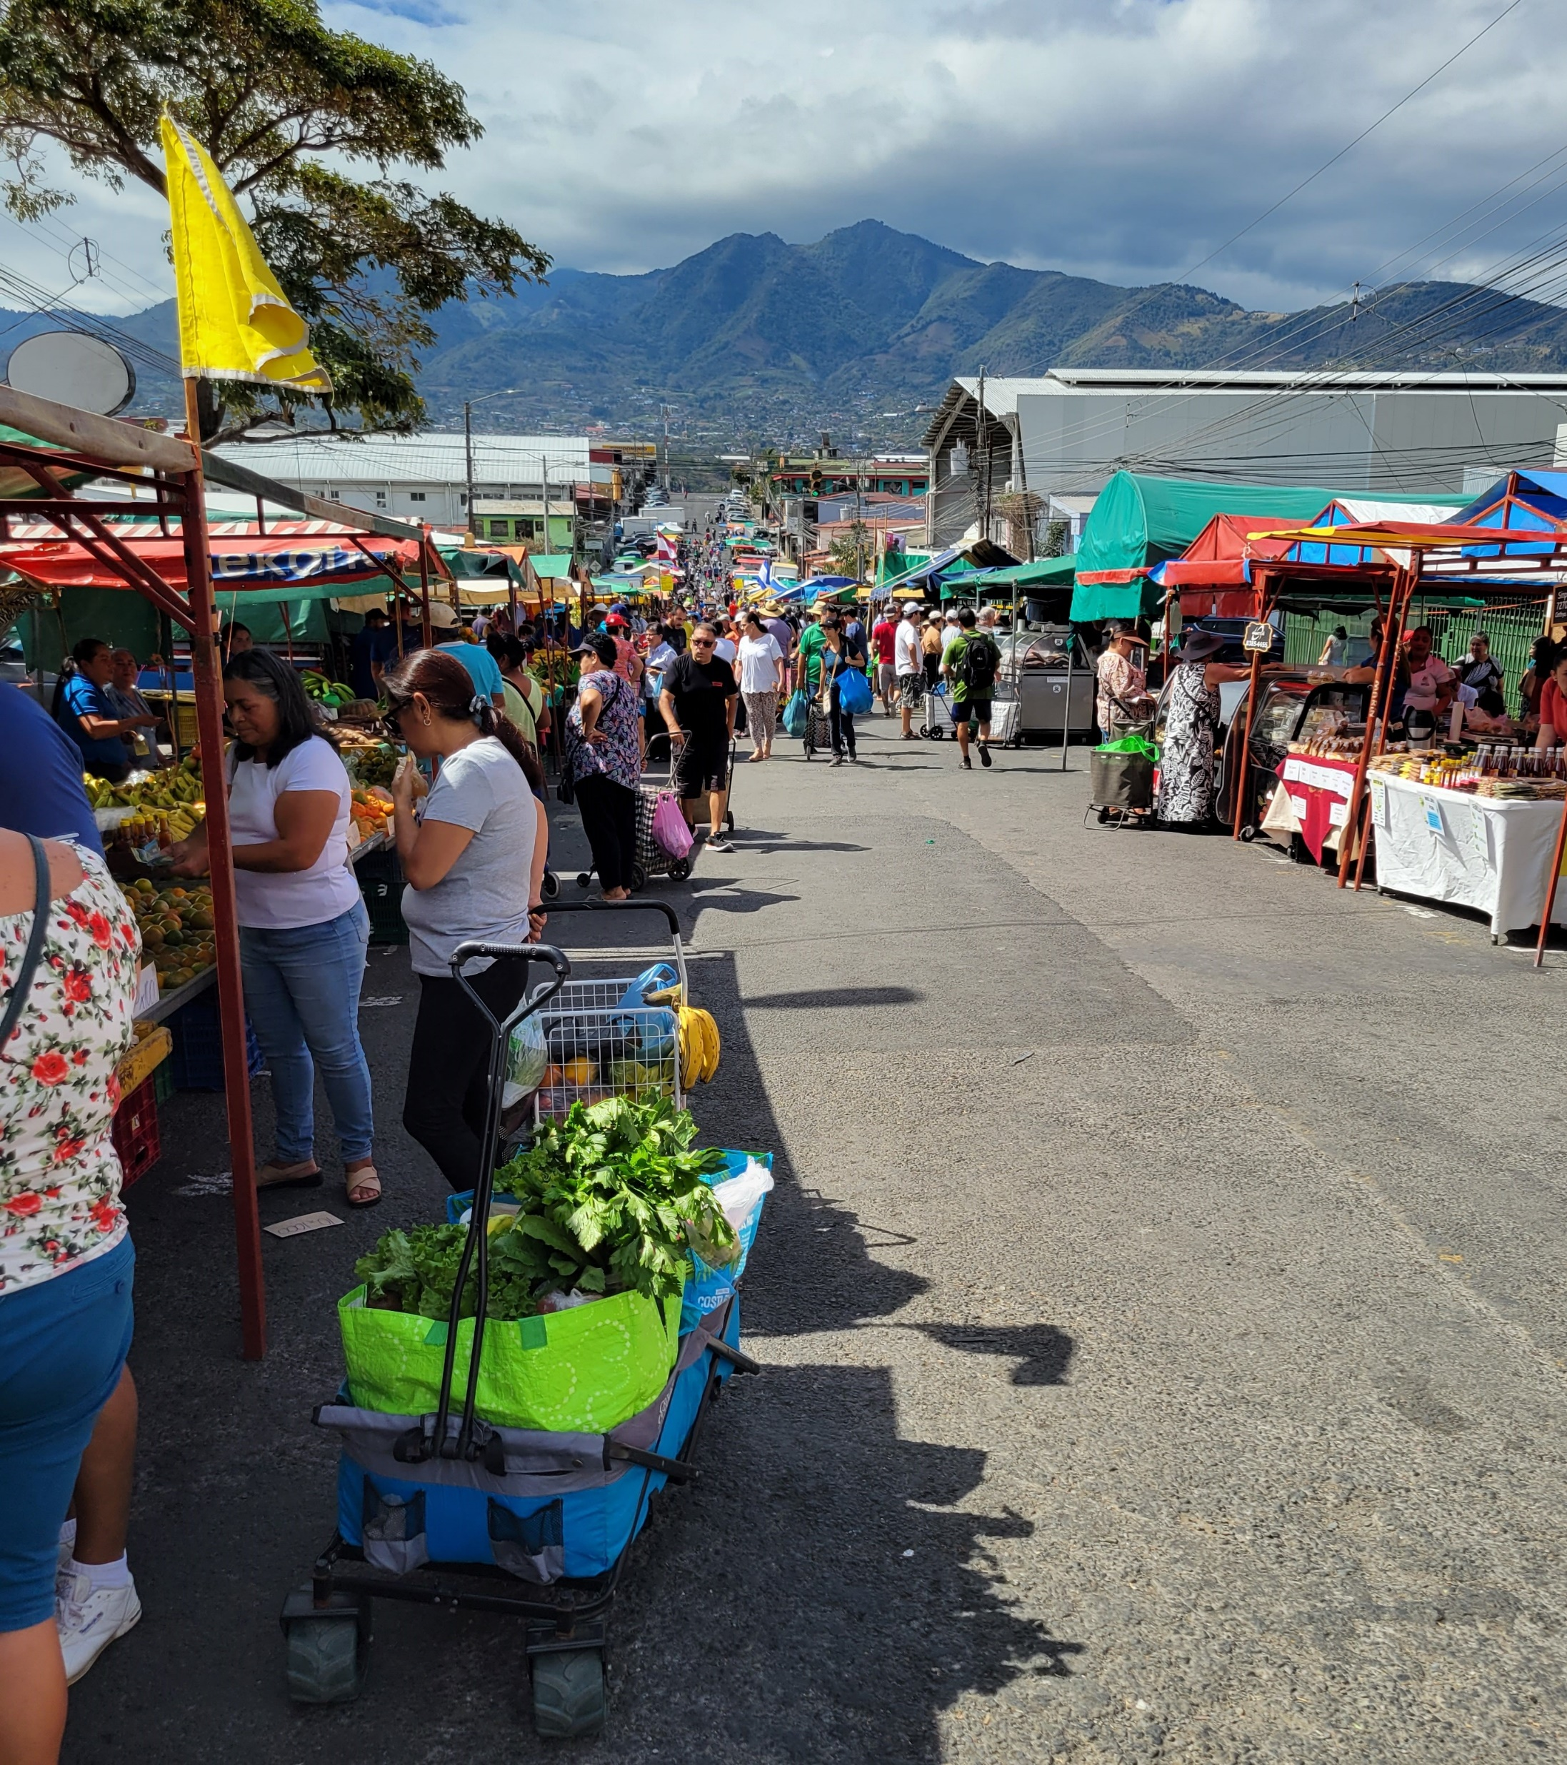
We will use data about farmers’ markets in San José to construct maps with Folium
In Spanish “ferias del agricultores” means “farmers’ markets” , and “feria verde” means “green market”
4/19/2023
© 2018 – 2023, Professor Patrick Slattery
7
image by Patrick J. Slattery
IS Lecture Presentation for Job ID 23771

Slide 8
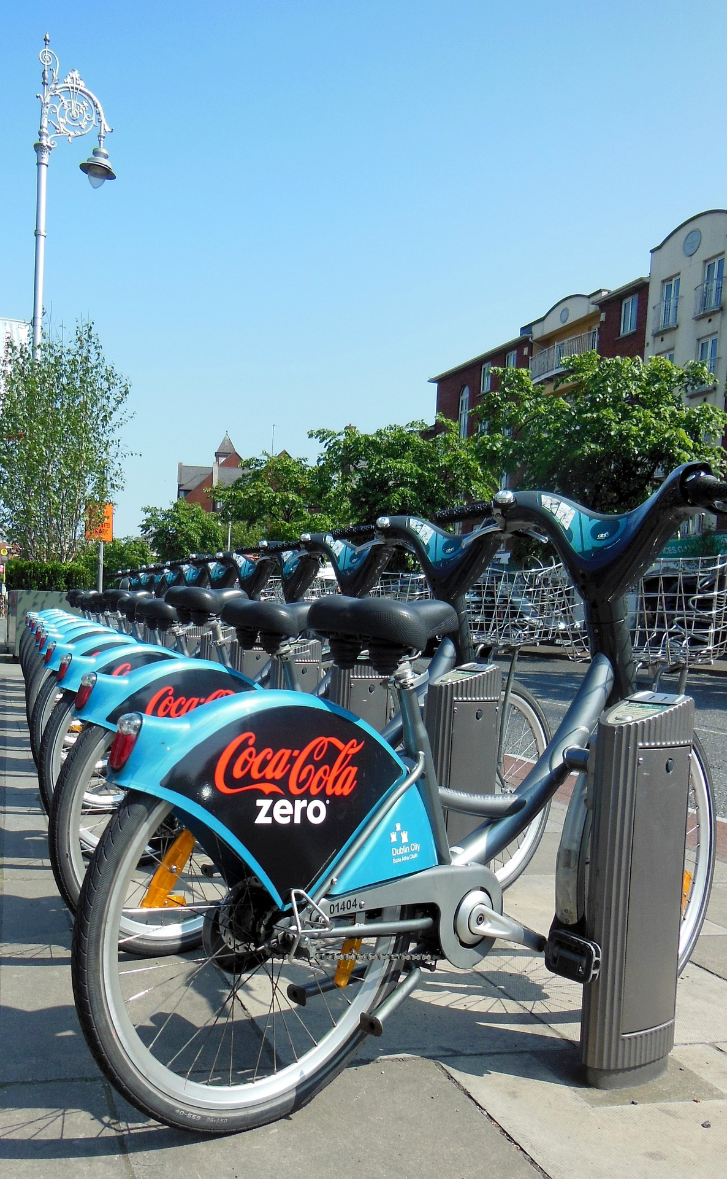
The Folium exercise to take away from today’s class works with bike rental data from Dublin, Ireland
In Irish (Gaelic) the word for “bicycle” is “rothar” , which just means “thing with a wheel(s)”
4/19/2023
© 2018 – 2023, Professor Patrick Slattery
8
IS Lecture Presentation for Job ID 23771
image courtesy of Franz P. Saurte on Pixabay.com

Slide 9
Before we practice making maps of ferias del agricultor (farmers’ markets), let’s discuss some of the concepts
About Folium
Maps and Tiles
Markers on Maps
IFrames (HTML Pop-ups)
4/19/2023
© 2018 – 2023, Professor Patrick Slattery
9
IS Lecture Presentation for Job ID 23771

Slide 10
Based on `leaflet.js`, Folium was created by Rob Story in 2013 and has an active open-source community offering updates and enhancements
Folium can be used for visualizing geospatial data
Choropleth maps
GeoJSON overlays
Heatmaps
Marker clusters
In addition to those map styles, Folium offers customizable features
Custom markers
Pop-ups
Tooltips
4/19/2023
© 2018 – 2023, Professor Patrick Slattery
10
IS Lecture Presentation for Job ID 23771

Slide 11

Maps and Tiles
Map tiles are essentially small, square images that represent a specific section of the Earth's surface at a particular zoom level. The entire map is divided into a grid, where each cell corresponds to a map tile. As you zoom in or out on a map, the tiles are fetched and displayed to provide a smooth, seamless experience.
When creating maps with the Folium library, you need to choose a base map or tileset to serve as the foundation for your map.
The base map is made up of map tiles that are sourced from various providers like OpenStreetMap, Mapbox, or Google Maps. Each provider offers different styles and levels of detail, so it's essential to choose a suitable base map for your specific needs
4/19/2023
© 2018 – 2023, Professor Patrick Slattery
11
IS Lecture Presentation for Job ID 23771

Slide 12
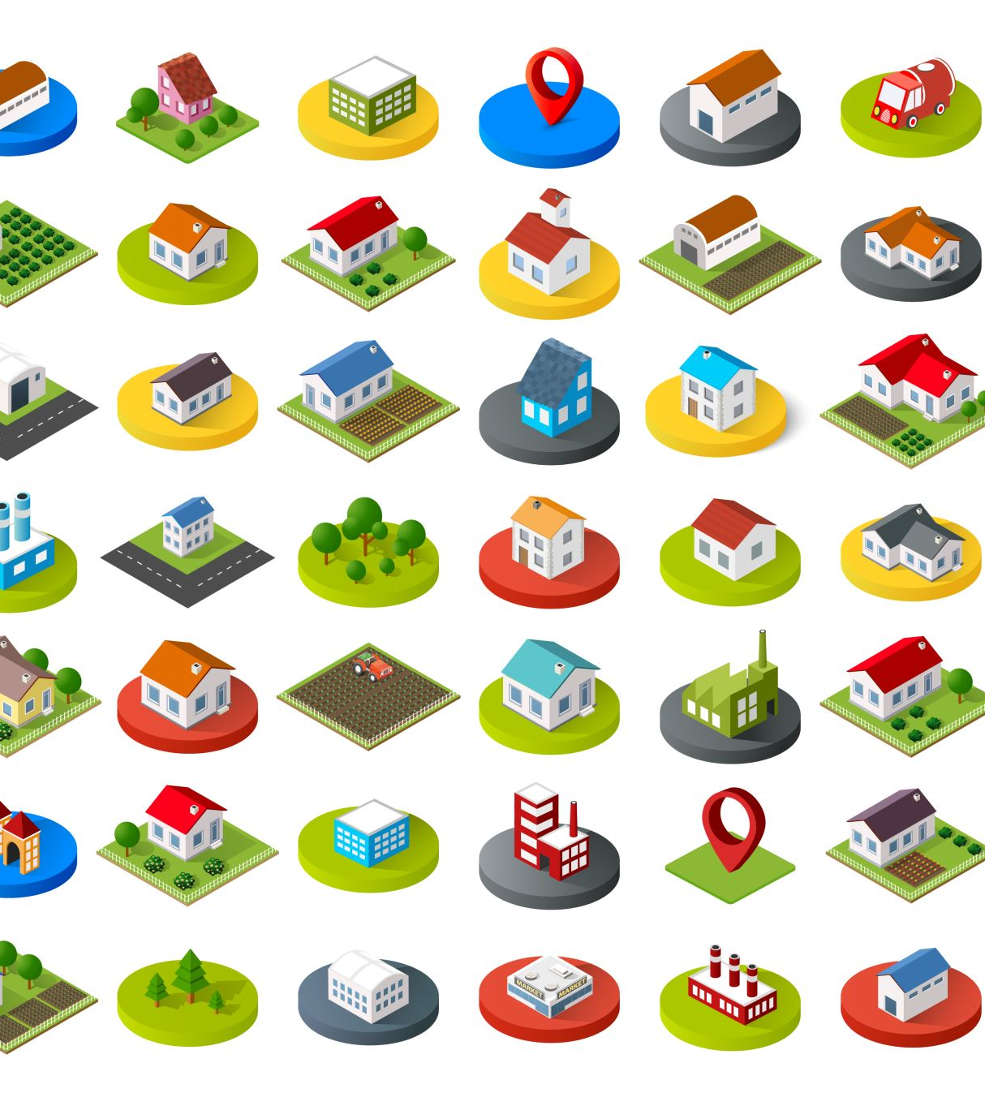
Markers on Maps
Markers are visual symbols placed on a map to represent specific locations or points of interest. They can be used to highlight various types of information, such as addresses, landmarks, or event locations.
Markers can also be customized with different colors, icons, and even images to make them more visually appealing and informative.
4/19/2023
© 2018 – 2023, Professor Patrick Slattery
12
IS Lecture Presentation for Job ID 23771

Slide 13

IFrames (HTML pop-up) (Tooltips)
IFrames, or Inline Frames, are an essential component when working with Python's Folium library to create interactive maps with advanced content.
An IFrame is an HTML element that allows you to embed and display content from an external source within a web page. It can be used to include various types of content, such as multimedia, documents, or even other web pages, in your map's pop-ups and tooltips.
By utilizing IFrames, you can incorporate images, videos, charts, or even entire web pages into your map's pop-ups, providing a more engaging and informative user experience.
4/19/2023
© 2018 – 2023, Professor Patrick Slattery
13
IS Lecture Presentation for Job ID 23771

Slide 14
Configuration & Colab Notebook (IS Lecture Presentation)
Patrick J. Slattery for Job ID 23771, 20-Apr-2023

Slide 15
Let’s work with Folium in Python using a Colab notebook.
This lesson works with an accompanying Jupyter notebook on Google Colab at https://bit.ly/is_lecture_presentation
Follow along with your copy of the notebook or use this link: https://bit.ly/is_lecture_presentation
4/19/2023
© 2018 – 2023, Professor Patrick Slattery
15
IS Lecture Presentation for Job ID 23771

Slide 16
Agenda
Zoom Notice, Introduction and, and Configuration | completed
Create a Basic Map in Folium: San José feria | completed
Markers in Folium: San José feria | completed
Some Fun with IFrame Markers: San José feria | completed
Exercise: Dublin Bikes | completed
Q&A and Housekeeping | 01:15 – 01:30

Slide 17
Q&A and Housekeeping
Patrick J. Slattery for Job ID 23771, 20-Apr-2023

Slide 18
Housekeeping
Blackboard™ Access/Issues
Drops/Adds
Other Administrative Issues
Contact: Patrick.Slattery@canopach.com , or +1.347.694.7809 (w)
Office Hours:
Book office hours at: https://calendly.com/professorpatrick/20min
Remote Office – Zoom.us (Meeting: 3476947809, no password)

Slide 19
Next Steps
Next Class on DD-Mmm-2023 (Day) is On Blackboard
We will continue working with mapping in Python
Practice with your own version of Python:
In the Cloud with Google Colab:
https://colab.research.google.com
See you next class!

Slide 20

Practice with maps in Folium! See you next class!
Photo by Hansjorg Keller, unsplash.com
© 2018 – 2023, Professor Patrick Slattery
IS Lecture Presentation for Job ID 23771

